Slide 1
ClaimSphere Automation Project
Cucumber Framework

Slide 2











ClaimSphere Automation Framework (CAF)
CI Based Execution – Jenkins
Execution platforms
Test Automation Tools
KEY HIGHLIGHTS
Page Object model driven approach Extends to enable BDD through integration with Cucumber Multi-Platform support - Windows / Linux
BENEFITS
Design scalability (through ease in test script reusability and maintainability) Execution scalability (through CI and BDD implementation)
Test Suite Repository
Driver Script
Browsers
Data Handler
Page object
Handler
Config Handler
Databases
Component Libraries
Utility Libraries
Functional & Business Libraries
OS
Error & Exception Handler
Reporting Libraries
Product Under Test
Reports
Notes:
CAF is a framework for Behavior-Driven Development (BDD). It focuses on testing the features of program by defining the stories in scenarios that express the desired behavior in a textual format.
Overview of format (Given, When, Then)
A scenario is a collection of executable steps. In CAF it is expressed in Given, When, Then format.
Given step represents a precondition to an event
When step represents the occurrence of the event
Then step represents the outcome of the event

Slide 3
Environment
IDE – Eclipse
Web Driver – Selenium
Framework –BDD – Cucumber, TestNG
Build Tool – Maven
Logging – Log4j.xml
Reports – Extent Report
Version Control Tool :Tfs(Git)
CICD – Jenkins

Slide 4
Introduction of Cucumber Framework
Cucumber is a testing tool that supports Behavior Driven Development (BDD)
BDD is a software development approach that allows the tester/business analyst to create test cases in simple text language (English). The simple language used in the scenarios helps even non-technical team members to understand what is going on in the software project
Cucumber reads executable specifications written in plain text and validates that the software(Step definition) with reference to it, Specification consist of various scenario’s in feature file(Test Case)
In order for Cucumber to understand the scenarios, they must follow some basic syntax rules, called Gherkin.
Gherkin is a set of grammar rules that makes plain text structured enough for Cucumber to understand using keyword (Given,When,Then,And).

Slide 5
The scenario below is written in Gherkin.
Scenario: To load input files for measure and run the Measure Job
Given I navigate to "ClaimSphere" page
When I click on “CockpitMenu" in "Cockpit Home” page
Then I click on "Environment" in "Cockpit Home” page
And The below search criteria should return valid value
| Column Name | Column Value| Table Name | Select Criteria |
| Member_ID | ID078 | HDS.HD_QOC_Report | |
| Denominator | 1 | | |
| Numerator | 1| | |

Slide 6
Test Management Tool
Maven
Test automation and management tool used in ClaimSphere product
The main feature of Maven is that it can download the project dependency libraries automatically via POM.Xml.
POM includes all the configuration setting related to Maven. Plugins can be configured and edit in the <plugins> tag of a pom.xml file
It allows as to create projects using Project Object Model and plugins(Jars).

Slide 7
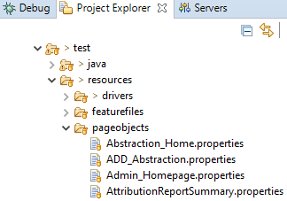
Page Object Model in Selenium
Page Object Model, also known as POM, is a design pattern in Selenium that creates an object repository for storing all web elements.
In Page Object Model, consider each web page of an application as a class file. Each class file will contain only corresponding web page elements.
Helps with easy maintenance: POM is useful when there is a change in a UI element or there is a change in an action. An example would be if a drop-down menu is changed to a radio button. In this case, POM helps to identify the page or screen to be modified. As every screen will have different java files, this identification is necessary to make the required changes in the right files.
Page Factory is an optimized way to create object repository in Page Object Model framework concept.

Slide 8
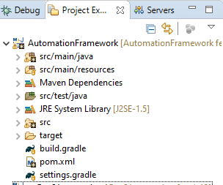
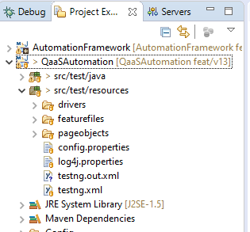
ClaimSphere Framework
Automation Framework Project
This Project consist of reusable common methods which can be used for all the module
QaaSAutomation Project
This Project consist of product specific methods

Slide 9
Test Execution Using TestNG
Writing a test in TestNG basically involves in insert TestNG annotations in your code.
Annotations were formally added to the Java language in JDK 5, and TestNG made the choice to use annotations to annotate test classes.
Annotations URL: https://www.tutorialspoint.com/testng/testng_basic_annotations.htm
We are using the Testng.xml to invoke the execution which contains
runner.java file
We used runner.java file to execute the required test cases/ Scenario's
Runner class consist of Cucumber option such as (Feature file path, Glue code path, tag name)
Feature file path-Test Case Path
Glue Code path-Stepdefinition path(Supporting Method)
Tag name-Indicates the Scenario's to be executed

Slide 10
Reporting
Extent Reports
Selenium provides inbuilt reports using TestNG on the console window which provides information on the steps that are executed as part of the test case
In order to deliver a detail statistical report to the major stakeholders we use Extent Reports which help us customize the format and required details
It generates the report in HTML format which is more presentable as shown in next slide

Slide 11
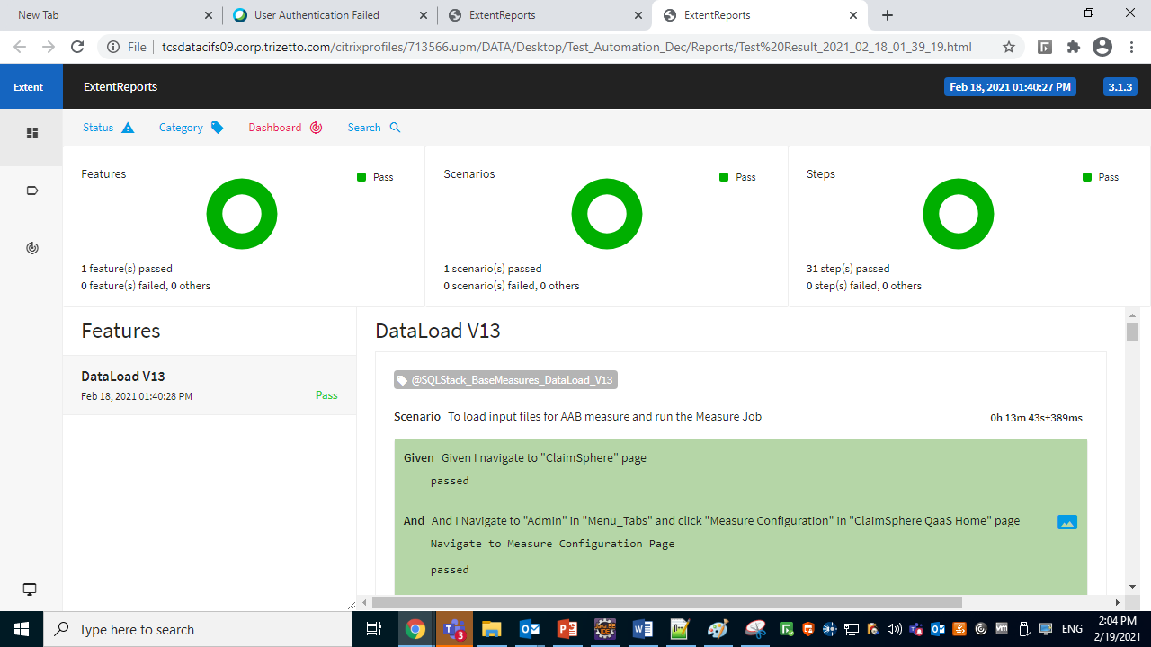

Slide 12
Thank You
.

